Slide 1
SmartMEDs
Outliers Team
Notes:
our project aims to solve tidus visits to doctors, for cough, or non serious situation, so it gives you a recommendation about the possible conditions you might have! and that simply works by predicting patient’s medical condition based on medicine review

Slide 2

Project Objective
SmartMeds is a recommendation system that gives patients the top recommended
medications which are reviewed by the community. It aims to reduce expenses (consultation fees) and wait times for patients.
The model used can recommend you the medication,
and also can work vice-versa i.e. if you provide it
with a drug name it can return you the possible condition.
The model is deployed in Custom ChatBOT that can help
you get as many information you want using certain
indicators in a calm and nice tune conversational way
Notes:
the reason why preferred chatGPT promoted engineering over building a website is that we needed the user to feel comfortable and interactive while while having that, website tend to have drop down menu and entering the result without any possible feedback or conversion

Slide 3
Project Process
Data collection
Exploratory Data Analysis
Data Cleaning
Preprocessing
Phase
HyperParameter tuning
Applying NLP Techniques
ChatGPT
(Prompt Engineering)

Slide 4
The Data
UCI Machine Learning Repository and it contains
215.063 instance
7 columns
Notes:
the reason why preferred chatGPT promoted engineering over building a website is that we needed the user to feel comfortable and interactive while while having that, website tend to have drop down menu and entering the result without any possible feedback or conversion

Slide 5
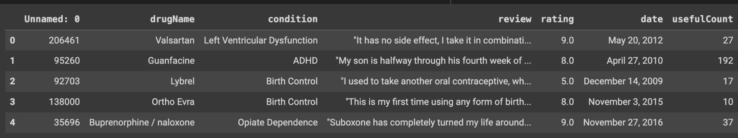
The Data
ID
Drug name
Condition
Rating
Date
useful-count
Notes:
he data was collected from the UCI Machine Learning Repository and it contains
String values
Date
Integer and Float
It consists of (215,063) instance and 7 columns
It is webscrapped from different websites of health care domains

Slide 6
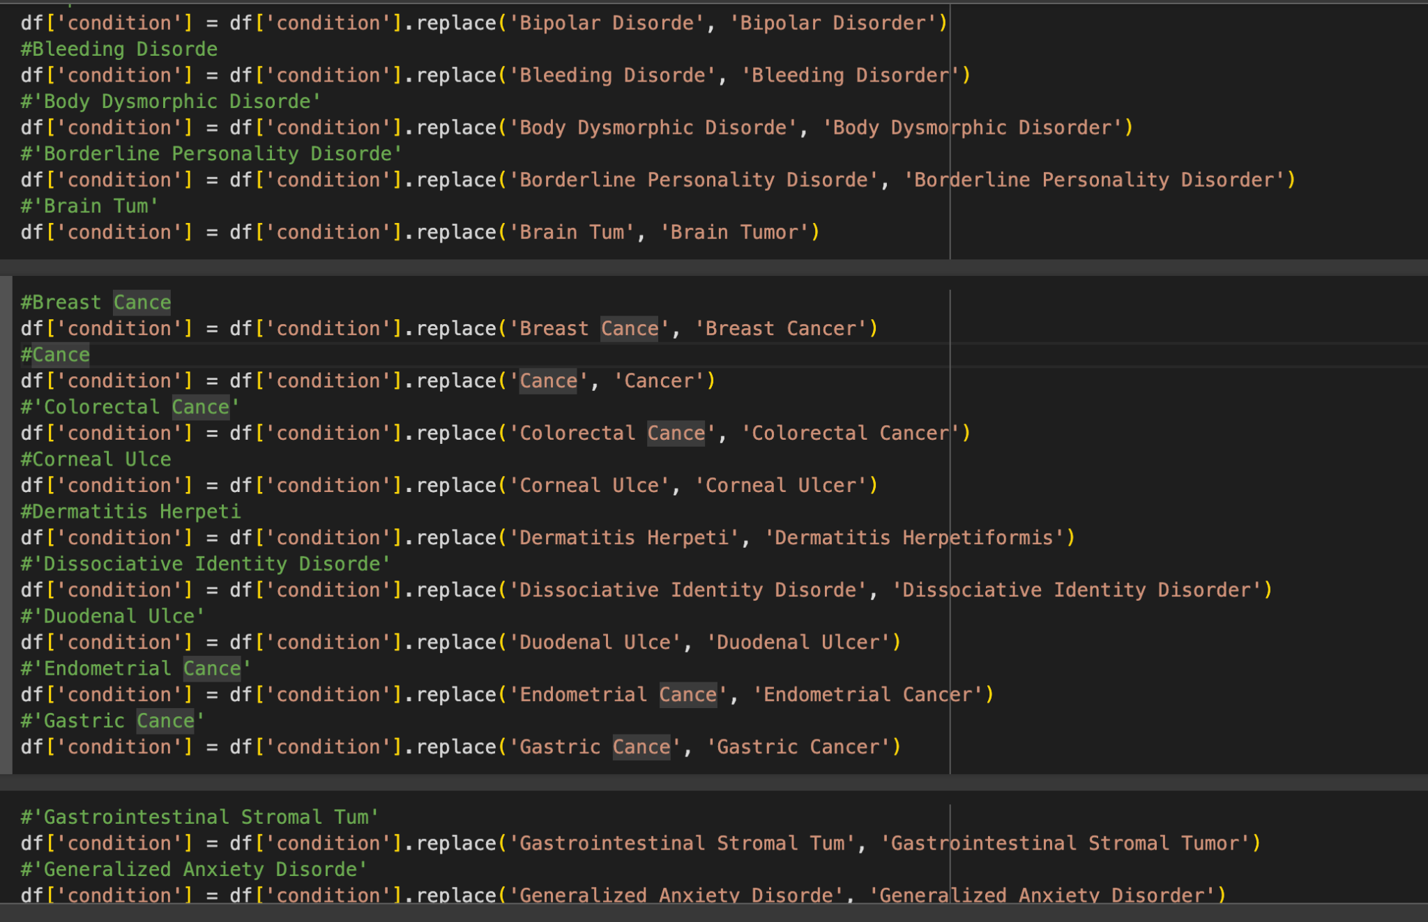
The Data Cleaning/Preprocessing
The Data contained a lot of invalid and null values, which required comprehensive manual examination and cleaning
Notes:
which is a problem with the data
we discovered after passing through all
instance of data and no just the head

Slide 7
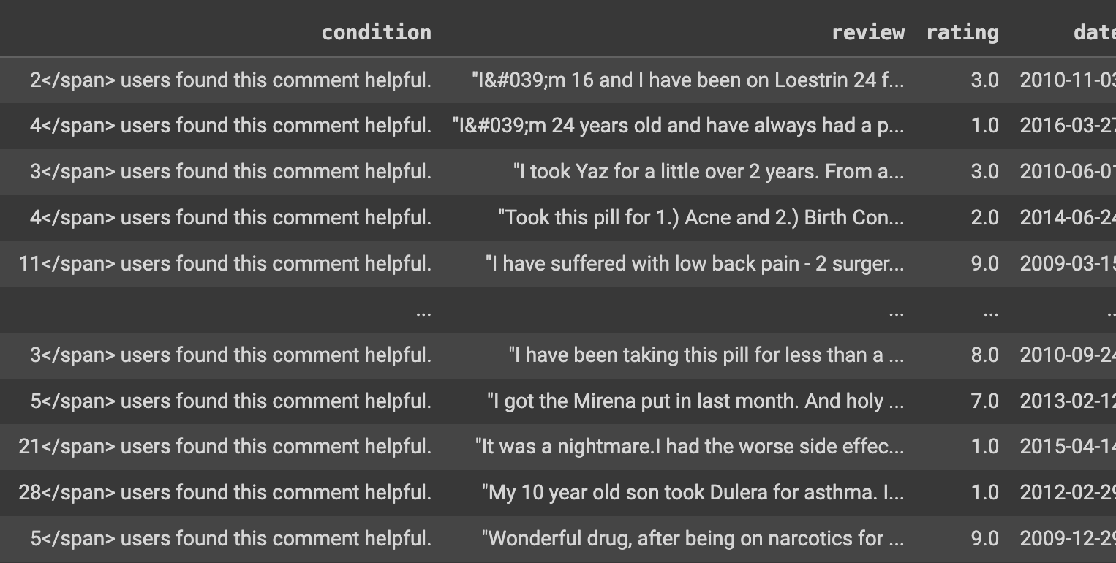

Slide 8
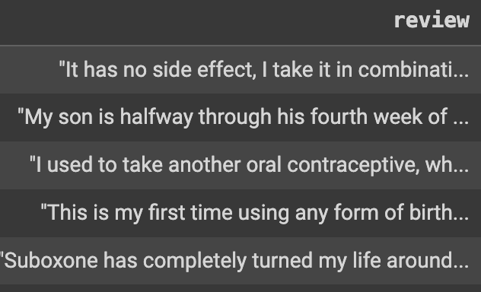
The Cleaning & Preprocessing
Remove values HTML entities in ‘conditions’ column (using RegEx)
Remove escape characters in the ‘review’ column to make it suitable for further processing
Out of Range (drug names, html entity values etc in ‘condition’ column)
Date Parsing
Stop words removal, tokenization and lemmatization on ‘review’ column
Natural Language Processing
sentiment intensity analyzer
Label Encoding

Slide 9
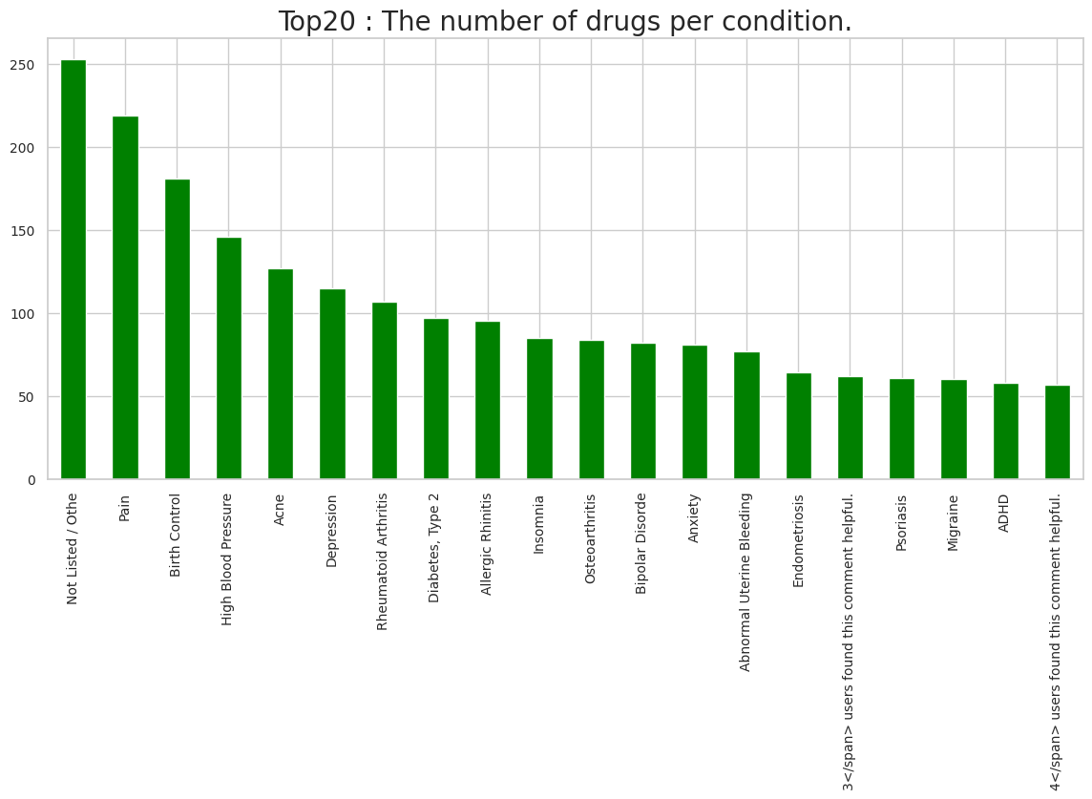

Slide 10
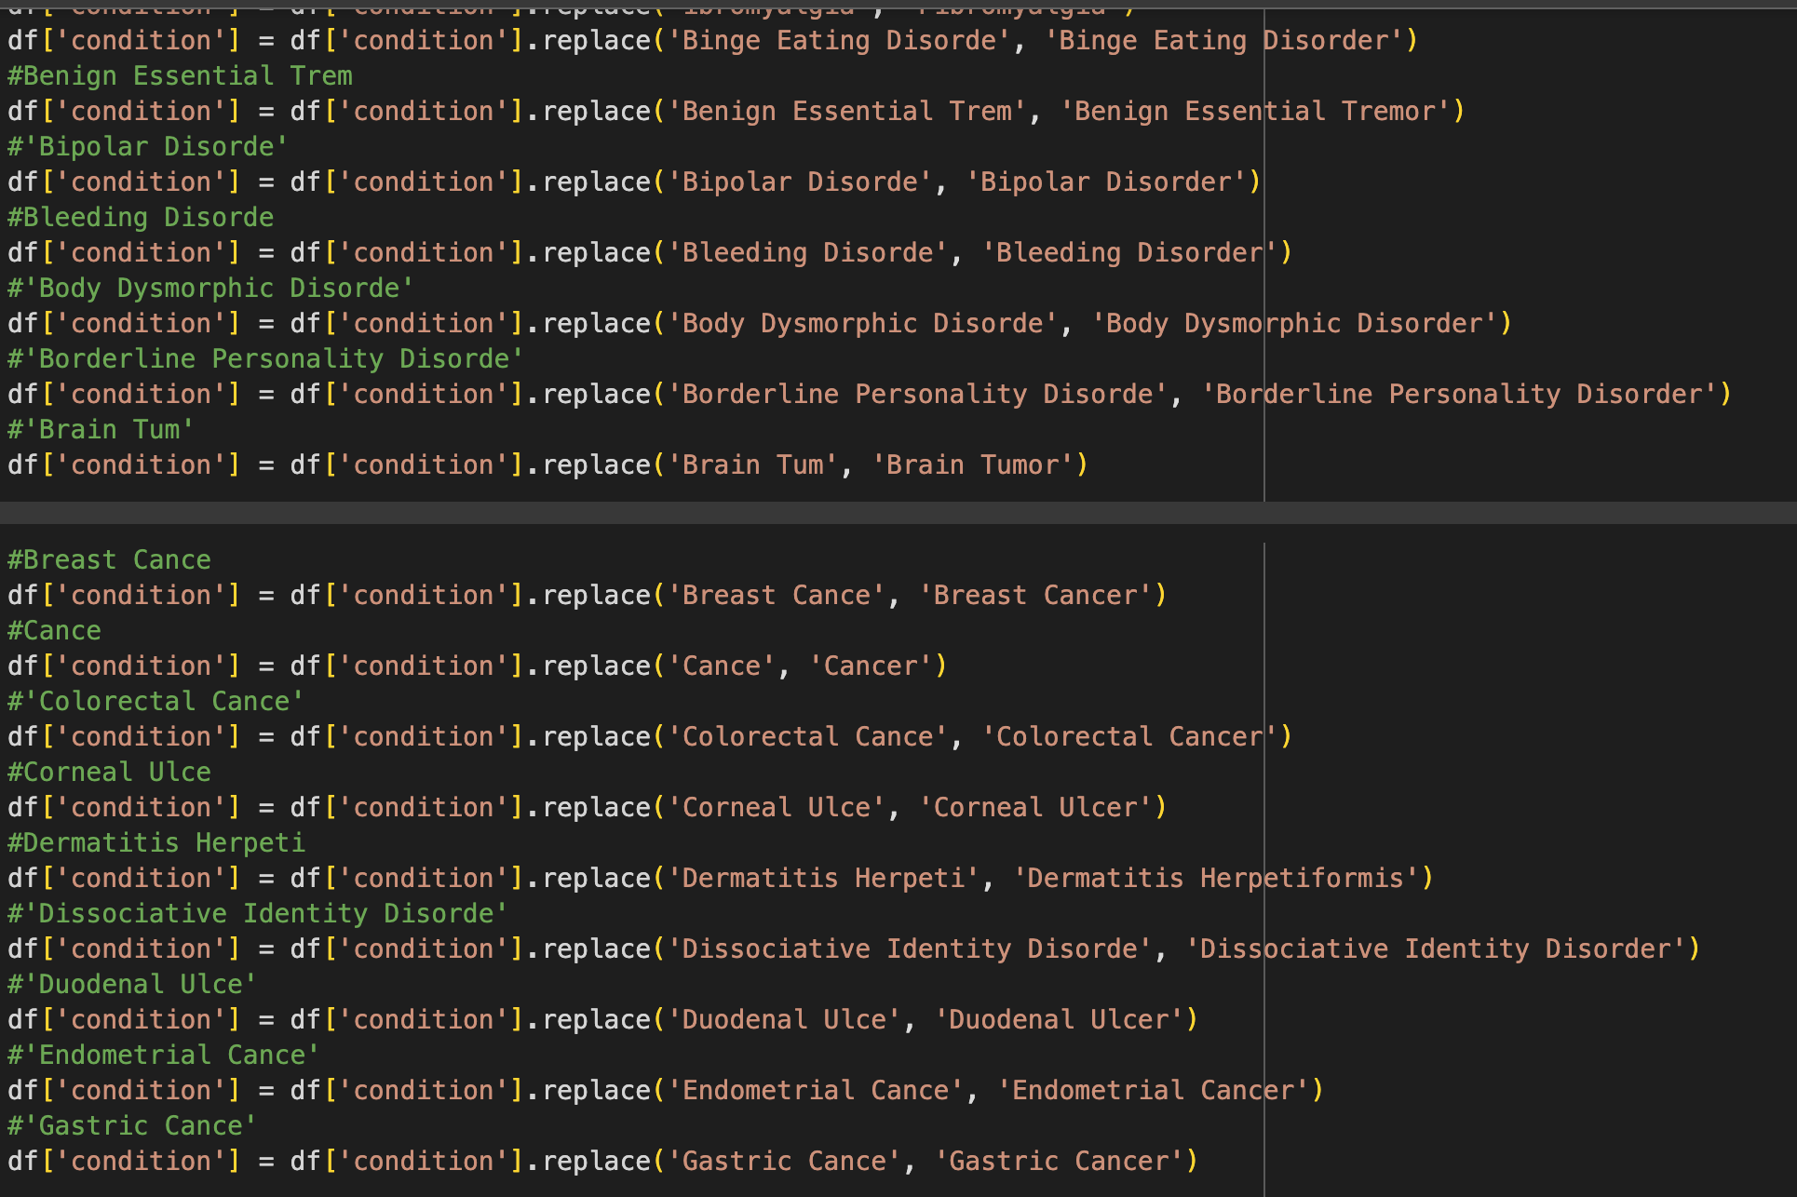
The Cleaning & Preprocessing
Using over 100 lines of code for manual cleaning and analysis

Slide 11
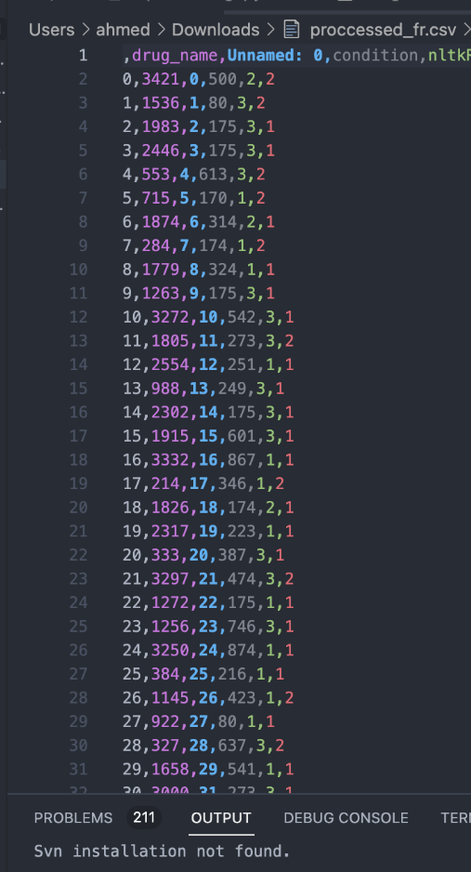
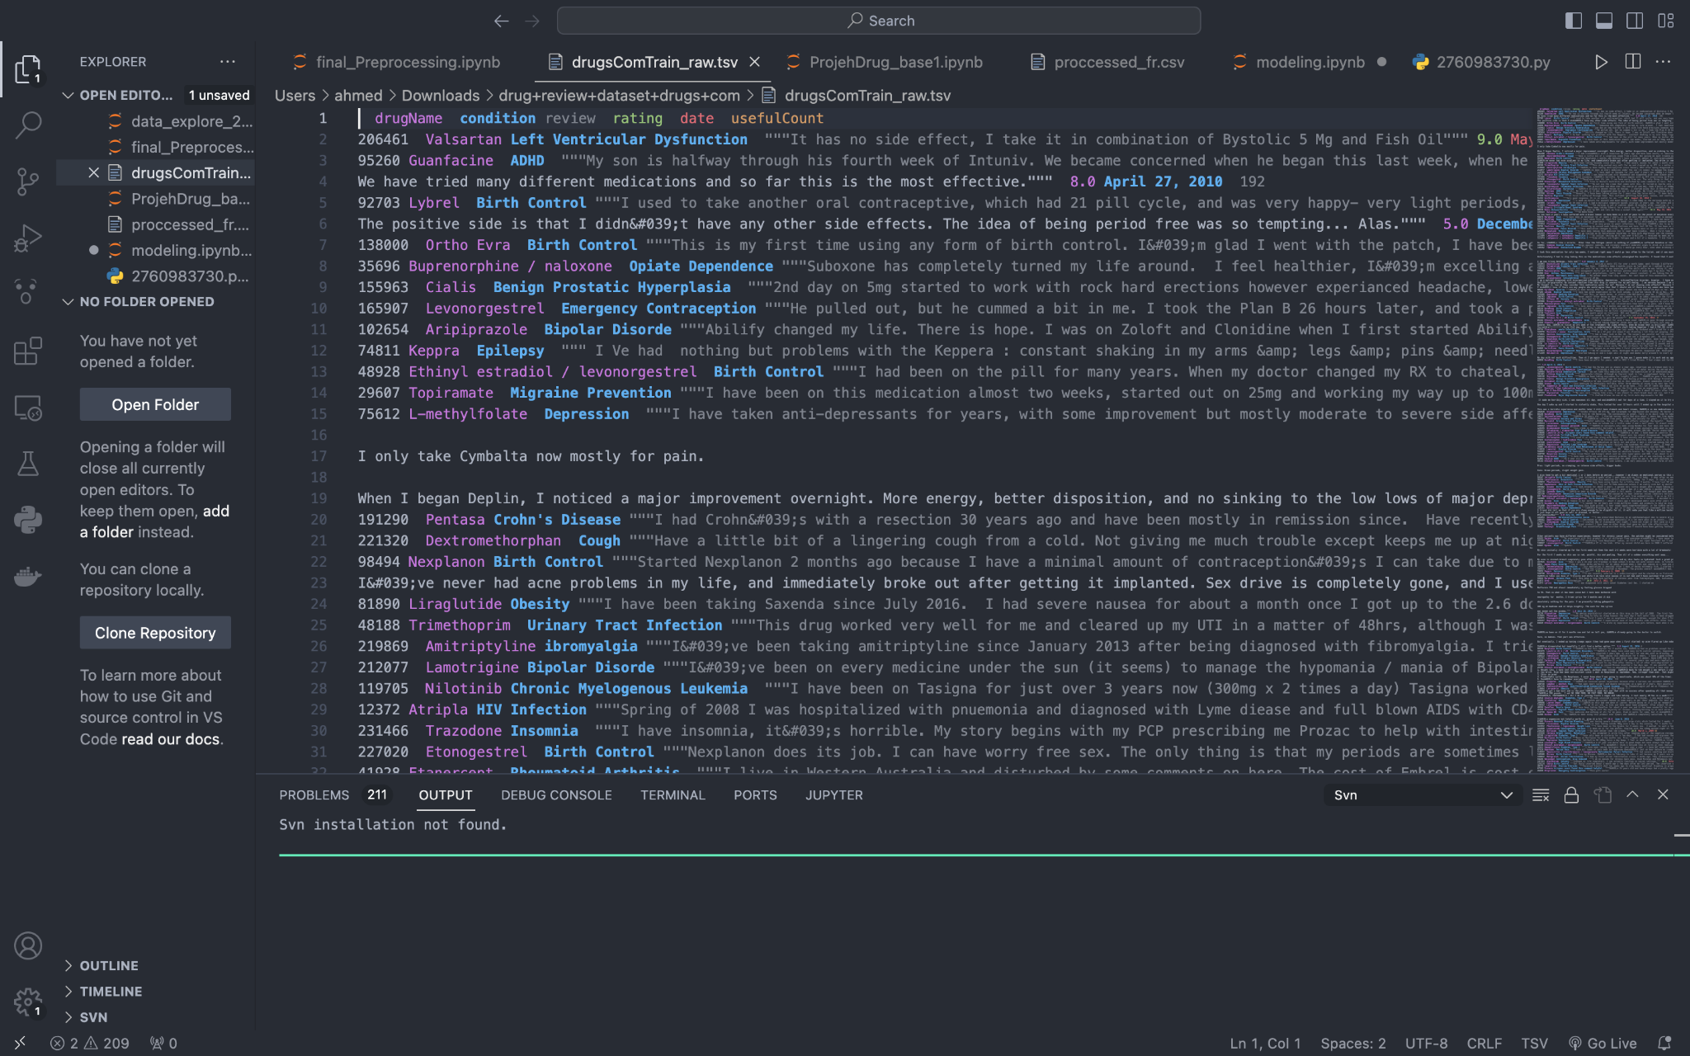
Encoding All the Values

Slide 12
Models used
Model name | Sklearn model name | Hyperparameter | Accuracy | Mean Absolute Error (degrees) | F-1 Score | Recall | Precision
Random Forest | RandomForestClassifier | Used with RandomizedSearchCV to find the best Max depth= 18 No. of estimators=255 | 0.68 | 85.01 | 0.68 | 0.68 | 0.68
Random Forest Regressor | RandomForestRegressor | Max depth= 18 No. of estimators=255 | 0.69 | 82.54 | 0.69 | 0.69 | 0.69
Decision Tree | DecisionTreeClassifier | Criterion = entropy max depth = [10,20, 25,50] used the best parameters using gridsearchCV | 0.72 | 75.94 | 0.72 | 0.72 | 0.72
KNN | KNeighborsClassifier | Using gridsearch with cross validation, the best n_neighbors was found to be n-neighbors=9 | 0.69 | 82.54 | 0.69 | 0.69 | 0.69

Slide 13


The Application
API App
Model
Conversational
Model
ChatGPT

Slide 14
Challenges
1. Imbalanced Data
Some of the classes in our data was just a noise and removing it wasn’t that easy
2. API
we configured the existing API to add symptoms to our data and it needed some parameters and more configuration
3. Modeling:
Due to the complexity of the data and its volume, our machines couldn't handle training on more powerful models, as some models are taking over 8 hours to train and also crashes sessions

Slide 15
Future Enhancement
Train the data in a more powerful model to improve the accuracy and relevance of medication suggestions. This includes considering additional factors such as patient demographics or medical history and fine-tuning the weighting of different factors in the recommendation process.
Apply API For a larger database and more information retrieval
Implement functionality to provide real-time updates and alerts to users, such as notifications about new medications or changes in recommendations based on updated information or user feedback

